Slide 1
Implementing several techniques for Data Analytics and Visualisation
Data Analytics and Visualisation
Student ID | Student Name
10612366 | Navin Kumar Singupuram

Slide 2
Agenda
Aim of the Assignment
Understanding of Dataset
Populating values in ETL using SSIS
Understanding SSRS report
Tableau Visualizations
Conclusion

Slide 3
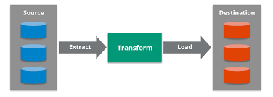
Aim of the Assignment
Understanding Data set and its Integration.
Creation of a Data Warehouse.
Hands-on experience on Data Migration
using ETL process.

Slide 4
Dataset
The Employee database is the dataset that was selected for the Data Analytics project.
Employee information is very crucial and essential for a firm where it is included with both the basic information and records of the employee history.
Employee Dataset (1985-2002)
Salary
Department
Department Manager
Department Employee
Title
Employee

Slide 5
Vision and Goals
The employee dataset contains salary information for all employees, along with their department, titles, and personal information like date of birth and date of hire, although not limited to the following:
Age distribution among employees according to the department.
Corporate wage costs are broken down by Department.
Worker gender according to the department.
Two Techniques for the Vision:
Approach 1:
Building a data warehouse and using the outputs as a starting point for developing data marts for the relevant stakeholders.
Creating a data mart to meet the requirements of the various stakeholders' businesses.
Approach 2:
The second technique involved creating a data mart with all of the company's current employees and then filtering out the rest of the applicants. To put it another way, omitting former employees.

Slide 6
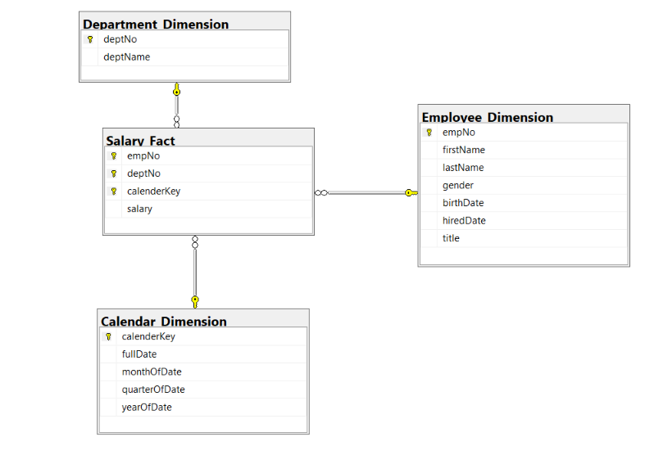
Star Schema
B9IS107 Data Analytics and Visualisation, Dublin Business School

Slide 7
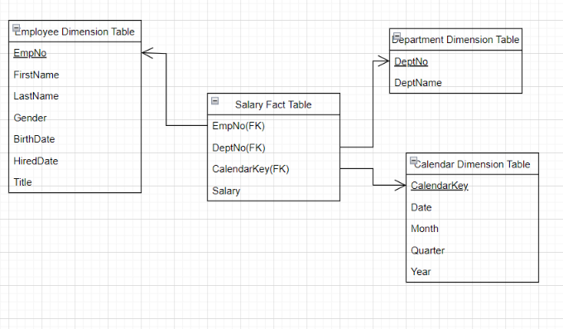
Dimensional Model
B9IS107 Data Analytics and Visualisation, Dublin Business School

Slide 8
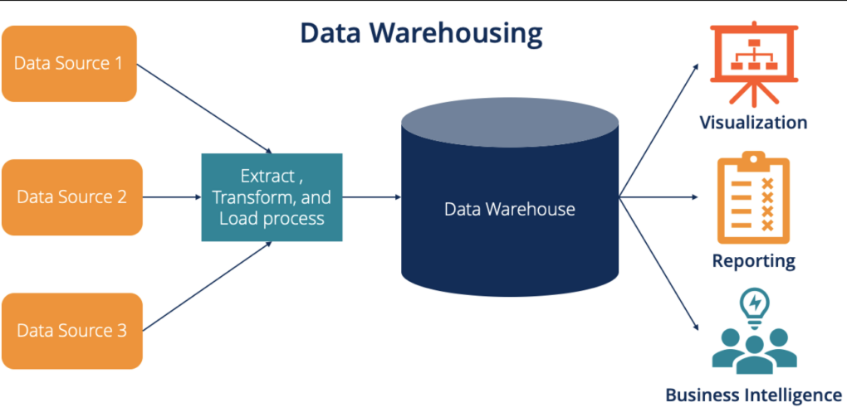
ETL PROCESS
B9IS107 Data Analytics and Visualisation, Dublin Business School

Slide 9
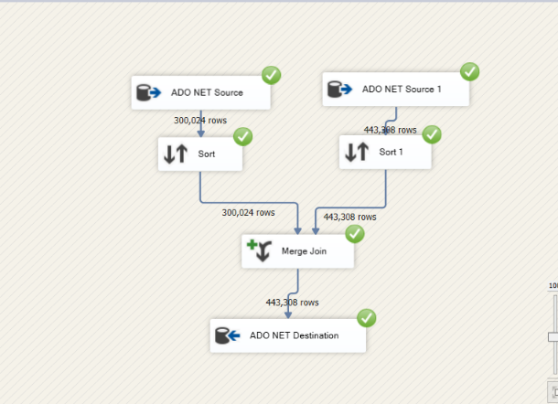
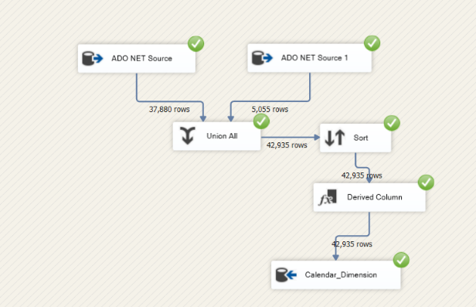
Calendar Dimension
Employee Dimension

Slide 10
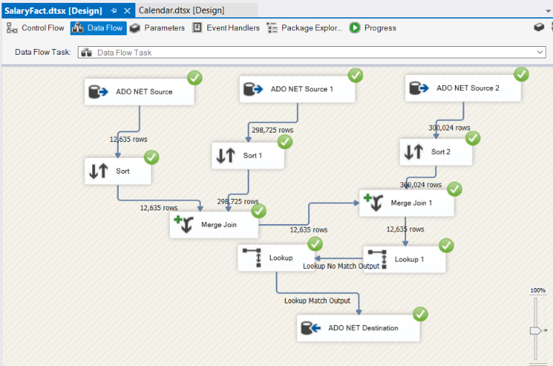
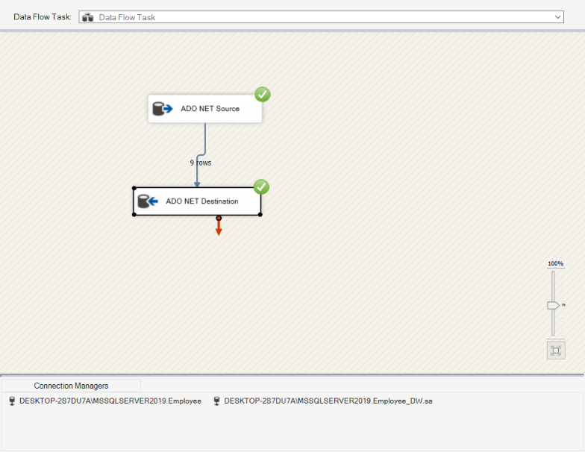
Department Dimension
Fact Salary Dimension

Slide 11
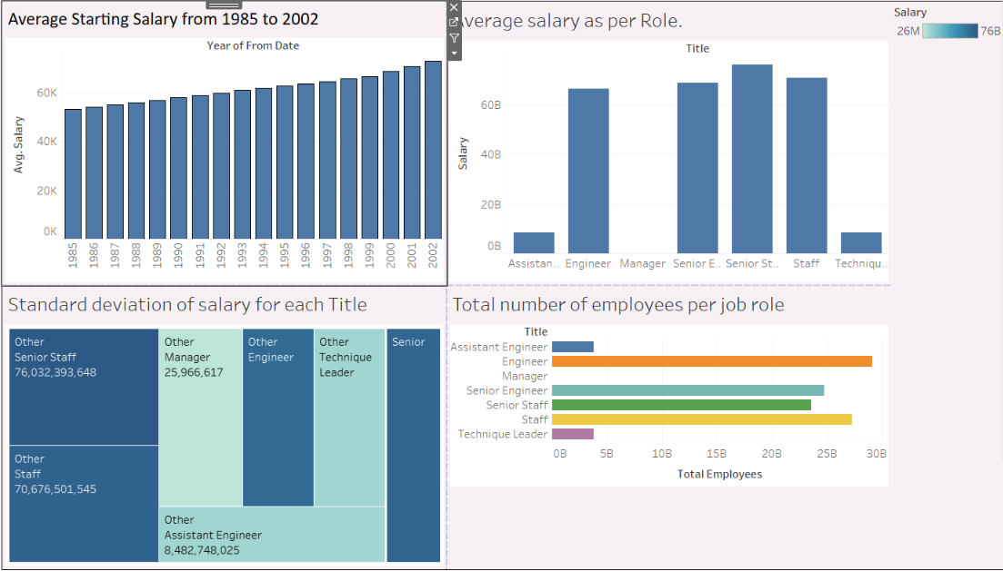
Visualization
Tableau is the fastest-growing data visualization tool in the Business Intelligence Industry. It helps you convert textual and numerical information to visual dashboards that help users see and understand their data
1. Yearly starting salary: How much has it increased between 1985 and 2002?
During the years, the salary has increased by 20k ($52k to 72k).
2. Number of employees per job role
Represents the number of workers in each employment role
3. Average salary as per Role.
4. SD (Standard deviation) of salary as per role
The salary difference between various roles.
B9IS107 Data Analytics and Visualisation, Dublin Business School

Slide 12

SSRS REPORTS
SSRS stands for SQL Server Reporting Services. It is a reporting tool developed by Microsoft that comes free with the SQL Server
Enables business intelligence
Reports created as a part of assignment :
Parameterized report
Drill down reports
B9IS107 Data Analytics and Visualisation, Dublin Business School

Slide 13
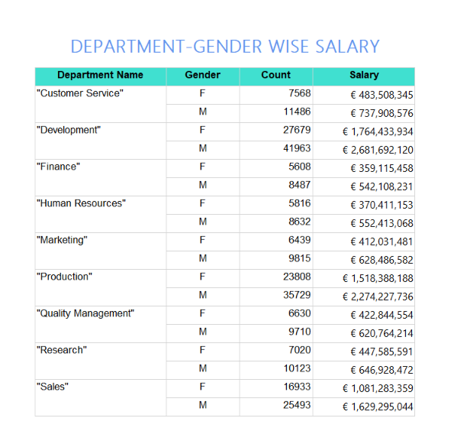
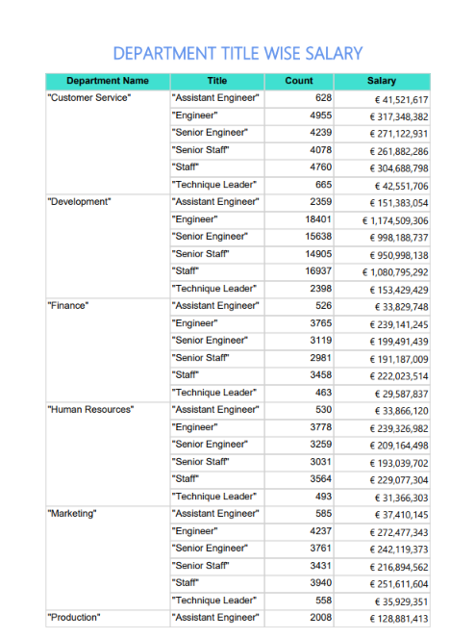
SSRS Report Data
B9IS107 Data Analytics and Visualisation, Dublin Business School

Slide 14
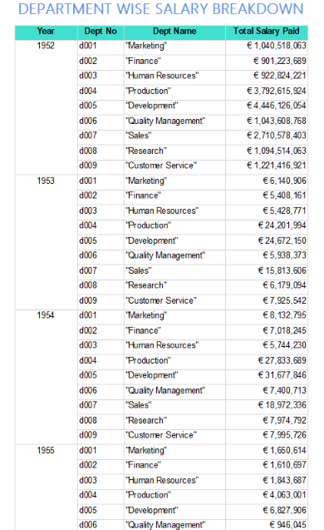
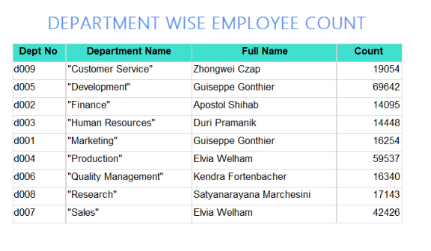
SSRS Report Data
B9IS107 Data Analytics and Visualisation, Dublin Business School

Slide 15

THANK YOU
B9IS107 Data Analytics and Visualisation, Dublin Business School

